Slide 1
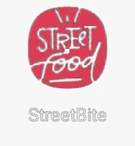


Presentation On Android Development :-
Presented By:-
Ashutosh Sharma
Adarsh Kumar
Harsh Singh
Sharjeel Alam
Shubham Samrat
Guided By:- Prof. Mani Sir
PRESENTATION

Slide 2

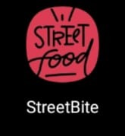

Application Name :-
StreetBite
Cause you cant runaway from hunger

Slide 3
Introduction :-
Almost everyone has a dream restaurant, including us.
We wanted to have our own restaurant so we came up with something close. A street food concept!
The stunning place where you can fulfill your appetite. I hope our food can provide warmth and blessing to each and every customer.
We stored hygiene so that we can attract more customers.
Clean restaurants will make customers feel very relaxed and comfortable. They’ll be very pleased to visit again.
Otherwise if it was not hygienic, customers will lose confidence and even cast doubt on whether the cleanliness of our food.
We will give the customers first impression that our food line up looks great in atmosphere.

Slide 4
Motto :-
They will feel pleased and comfortable when they are having their favourite cravings so I chose this place which is very beautiful. Moreover, we always entertain all guests with friendly manner. When the guests arrive, we greet the customers no matter how the customers are or how arrogant they are, this is because customers can never be wrong. We should let them feel that they are being respected.
Because :
“ If there is no customer, there is no business “

Slide 5
OBJECTIVE :-
We made sure we use fresh products and clean utensils.
Our cook even made sure that he wear gloves and chef hat while cooking and guarantee you the best authentication taste.
Our main objective is to be praised and loved by our customers and get to know good reviews about our street food after all customer satisfactory is all we need.
We want to expand our street food business into a bigger industry one day .

Slide 6
About Project & Module Description :-
This project contains following modules : –
Splash screen
Main Activity
Login
Registration
Table View
Menu View
Gratitude View

Slide 7

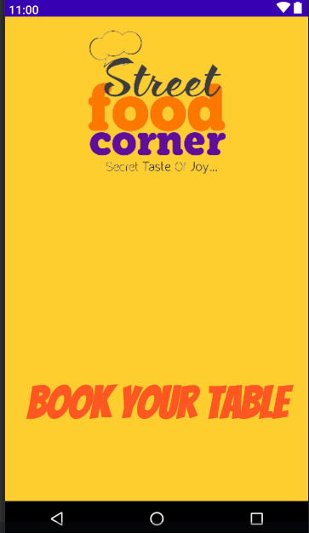
Splash :-
It will be used to introduce my app and do some background operations like bellow –
Check permissions
Check internet connection
Stablish connection to apis

Slide 8
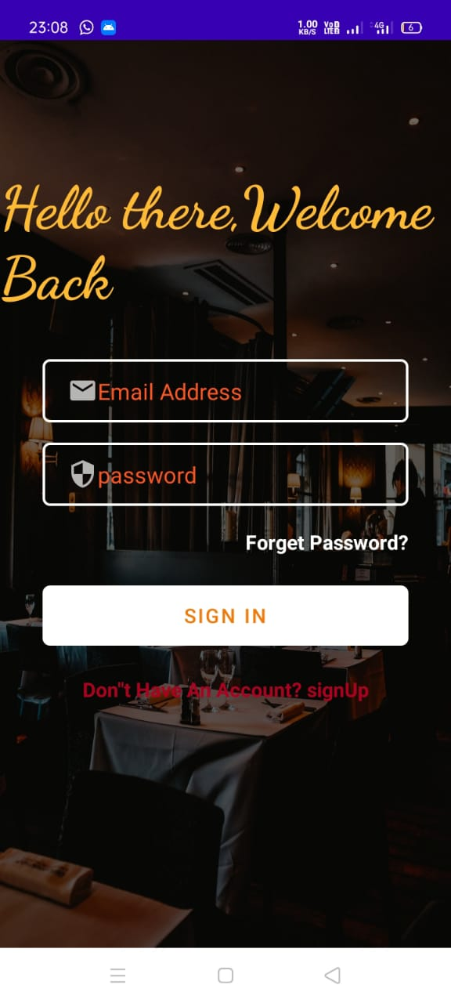
Login :-
This page will check your internet connection.
Ask for email id and password .
If you forget your password then you can also change your password by clicking on forget password.
You can also go to to signup page by clicking on sing up button.

Slide 9
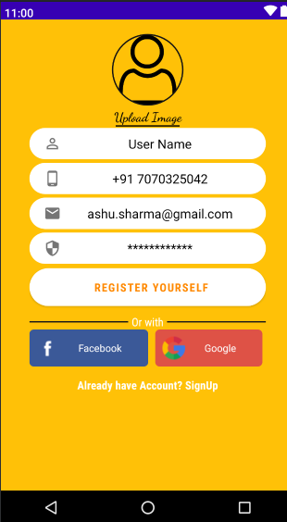
User registration module :-
In this page you have to give your unique User name.
Your phone number (You can also create your Account through Your phone number).
You have to give your email id to get register to my application.
And finally you have to give a strong password for security.
Here you can also login with your Google and Facebook account.

Slide 10
Conclusion :-
It was a wonderful and learning experience for us while working on this project. this project took us to various phases of android development and gave us a wonderful insight into the world of android development. we have learnt a lot from this project the purpose of this project was to book a Table in restaurant basically serving street foods. Through this street bite table booking app the user can book table in restaurant as well as view and choose menu before going restaurant by using this app. By this app we can save a lot of our time and provide the user with all the requirements that can be easily accessible in a mobile.

Slide 11
